Slide 1
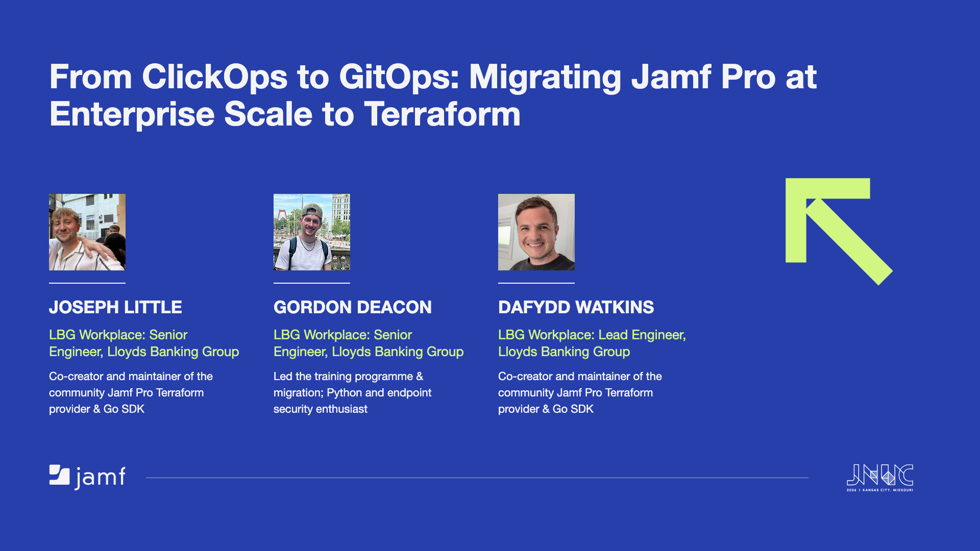
Notes:
Welcome. Premise in one line: three Jamf Pro instances, 1,500+ resources, moved from click-ops to Terraform - and what it took to do that inside a bank. Quick intros from the slide - name, role, and which part of the story each person tells.

Slide 2
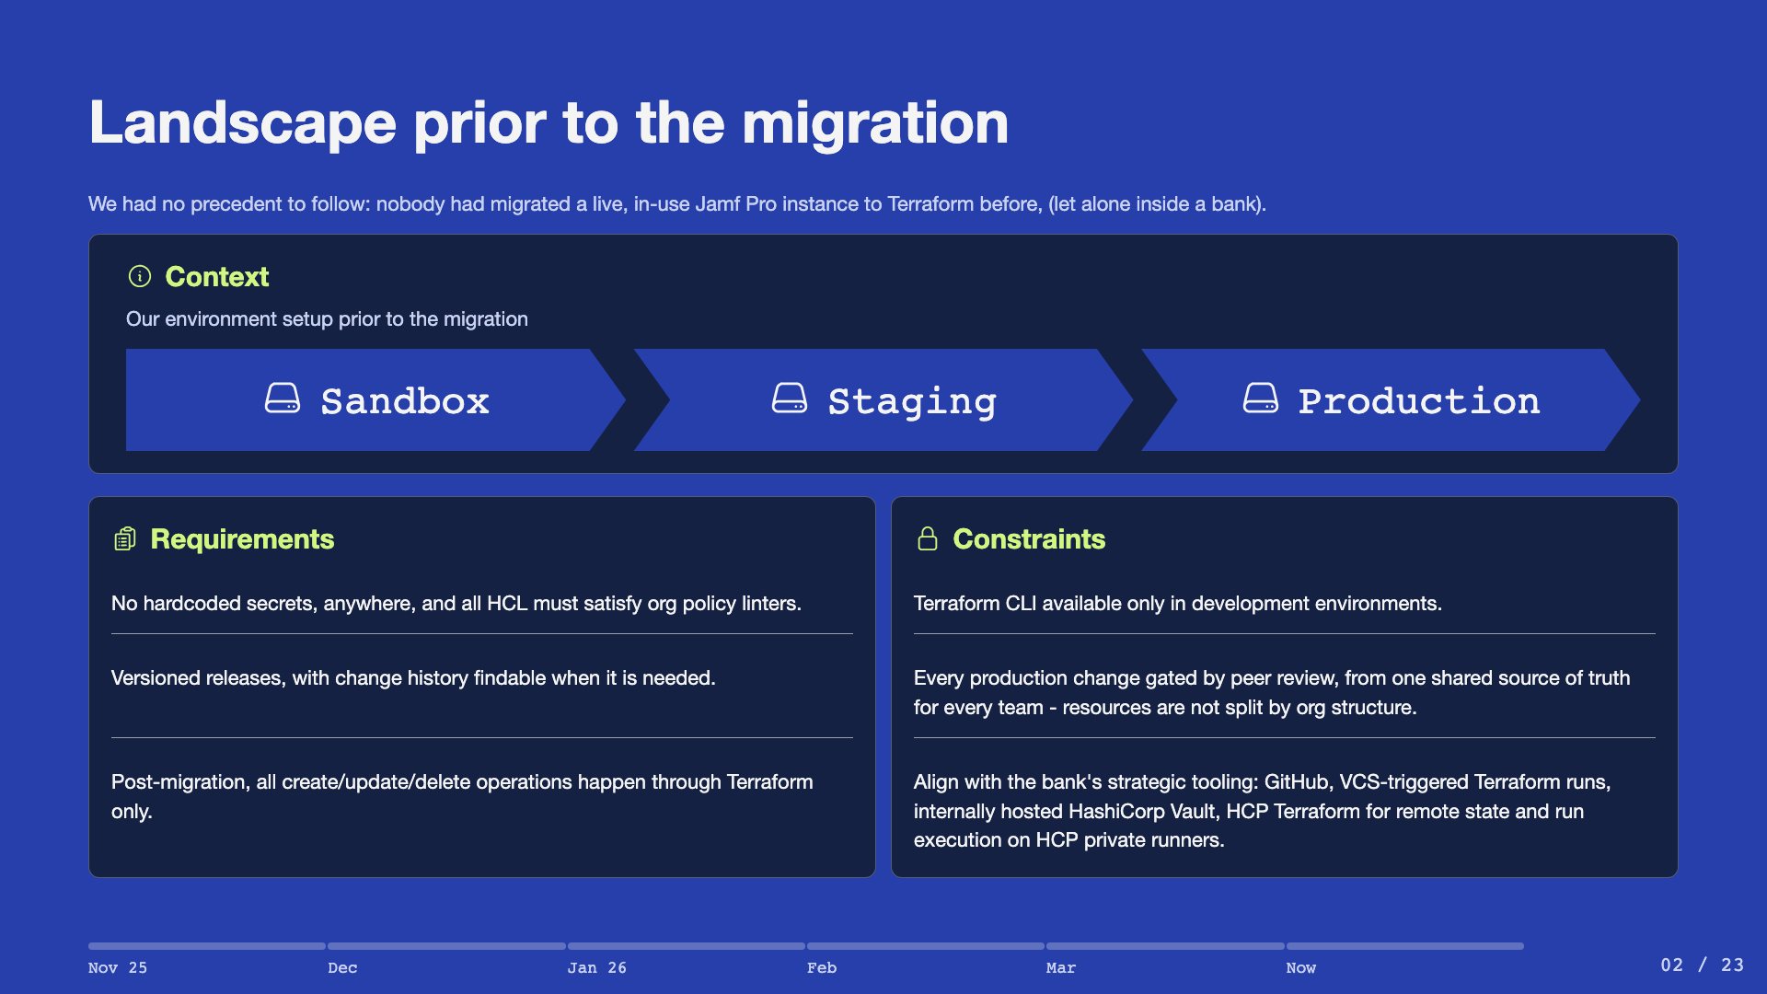
Notes:
This is a bank - the constraints are the story. No CLI outside dev means no local applies and no local state: everything flows through VCS-triggered runs. Staging was meant to mirror production but had drifted - that drift drives both the prod-first decision and the staging rebuild later.

Slide 3
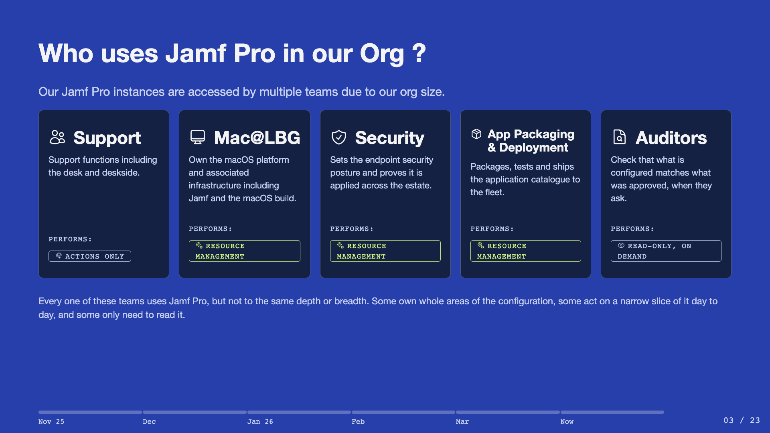
Notes:
Three teams manage resources, one config surface. Support acts on Jamf Pro day to day but doesn't hold resource-management access. Splitting the repo by team would fragment ownership of shared dependencies like categories and scripts. Auditors don't manage resources, but they do touch Jamf Pro - and because Terraform HCL is self-documenting, the repo can be given straight to them instead of building a separate audit trail.

Slide 4
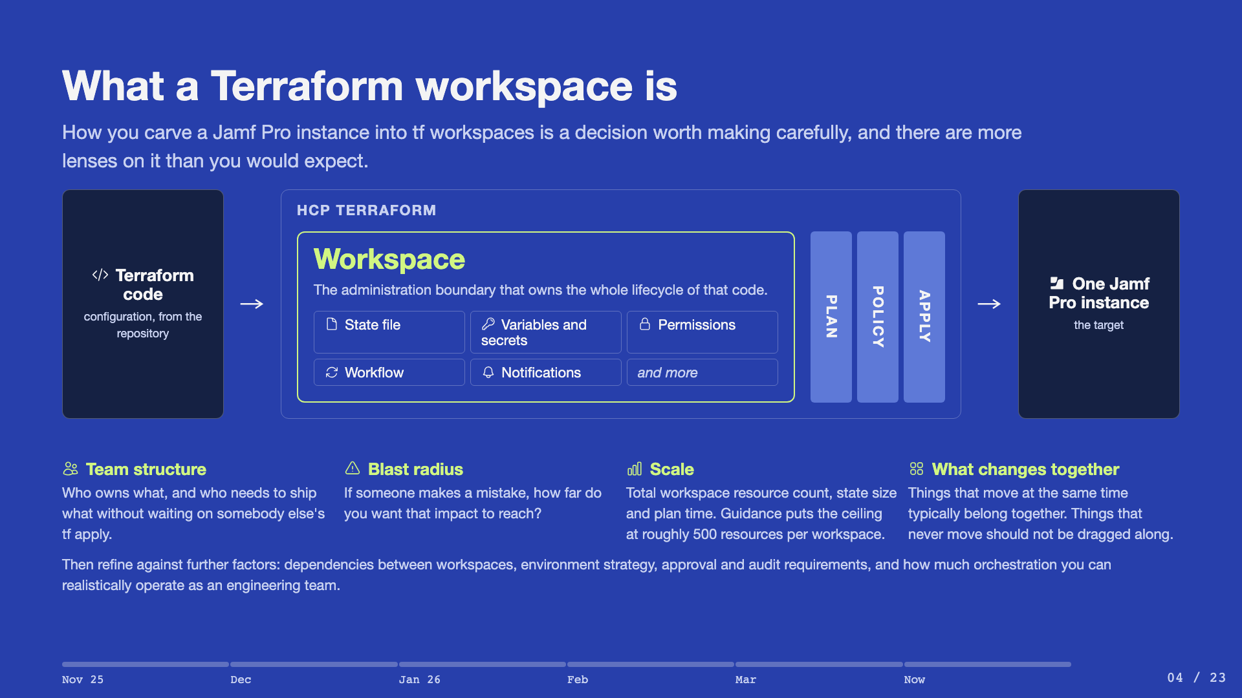
Notes:
Define it plainly first - one set of Terraform code linked to one state file. Walk the diagram left to right: code goes in, the workspace is the boundary that holds the state, the variables and secrets, the permissions and the workflow, and a run comes out as a plan, then a policy check, then an apply against one Jamf Pro instance. Take the four lenses in order and give an example of each from our own split rather than reading them out. The last line is the honest caveat - there are more considerations than fit on a slide, and they refine the choice rather than drive it.

Slide 5
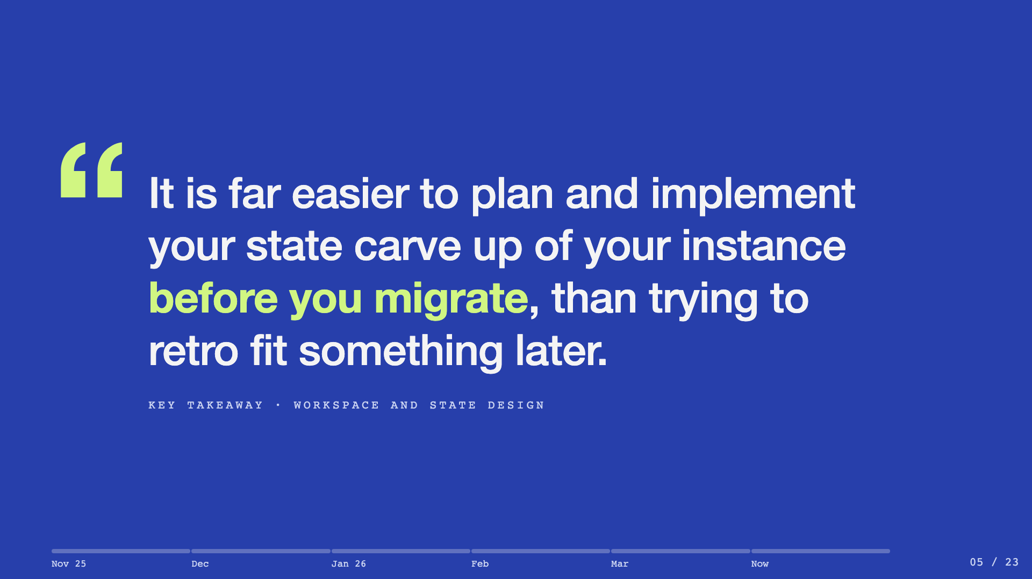
Notes:
Slow down here. This is one of three things we want the room to leave with. Say it once, then stop talking. The state carve up is the decision that is cheap now and expensive later, because re-cutting it means moving state.

Slide 6
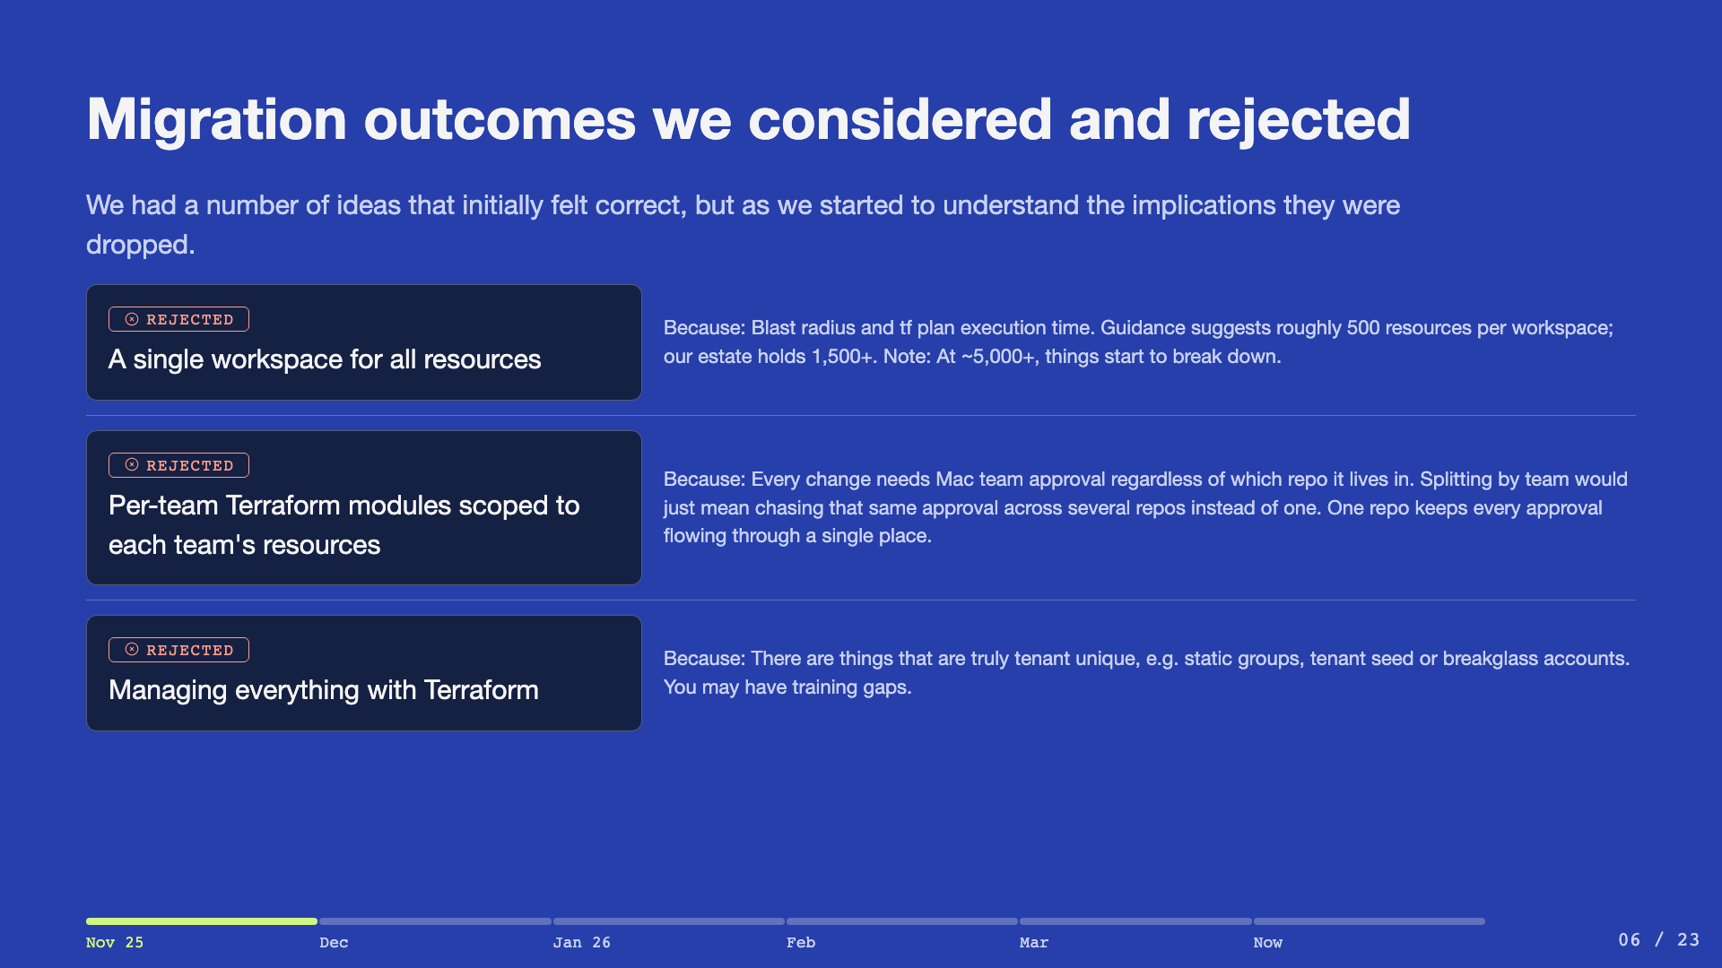
Notes:
Expect pushback on "not everything in Terraform" - defend it: some things are genuinely tenant unique, like static group membership and seed or breakglass accounts, and troubleshooting must not require a pull request.

Slide 7
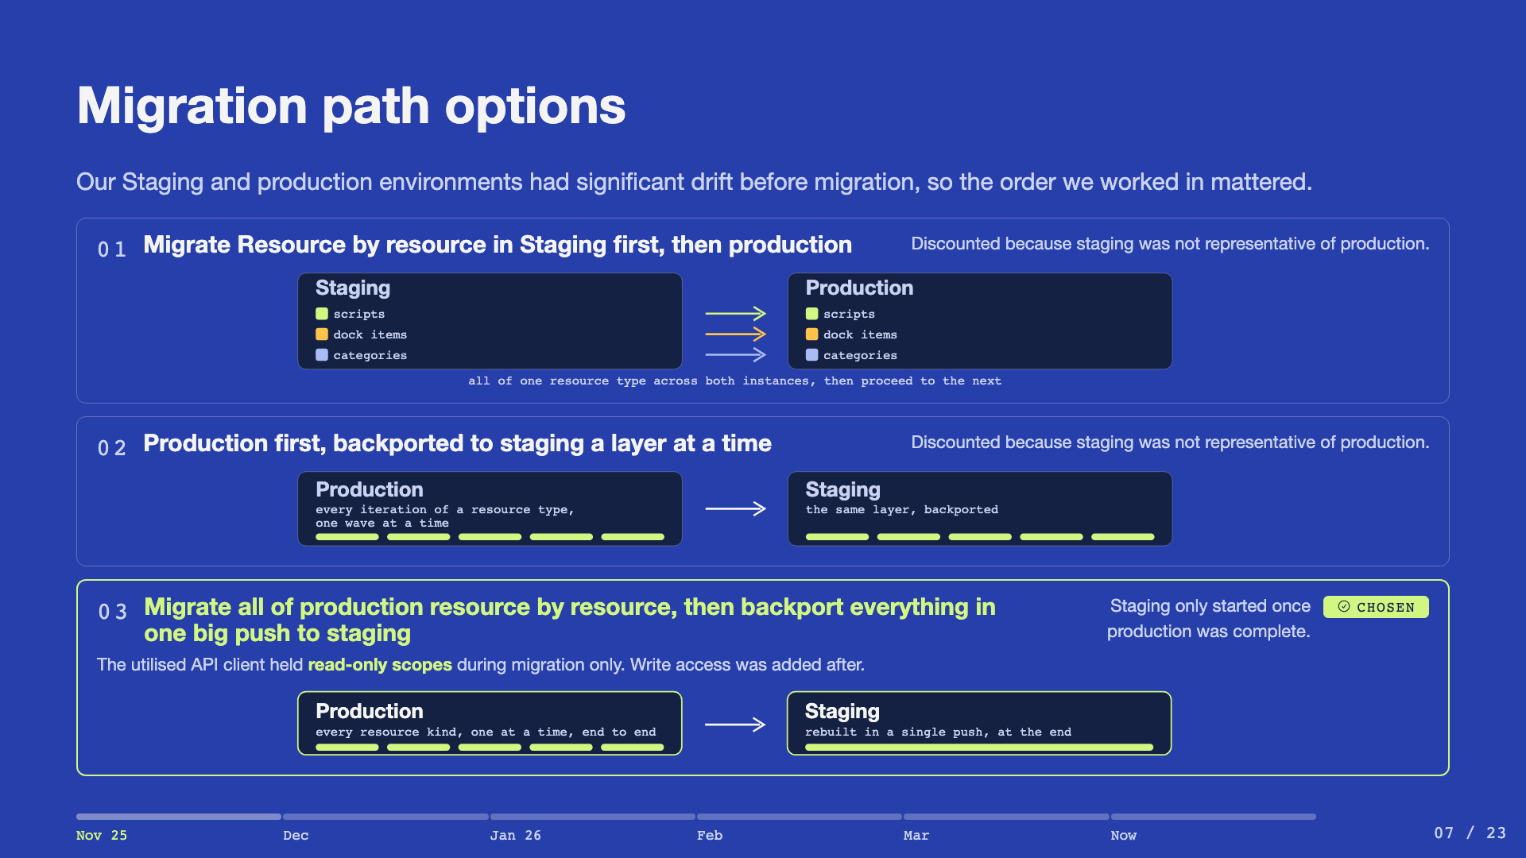
Notes:
Three paths were genuinely on the table. Walk each diagram left to right - the left box is where a change lands first, the right box is where it goes next. On path one the colour is the resource type - scripts, then dock items, then categories - and the same colour appears in both environments, so you can see all of one kind crossing before the next one starts. Paths one and two both keep staging in the loop while production is still being built, and that is what killed them: staging was not representative, so validating against it proved nothing. Path three leaves staging until production is finished, which is the whole difference between it and path two. Prod first is counterintuitive on purpose. Importing is read-then-manage - with a read-only API client there is no write surface, so it is safer than it sounds. Write scopes were only widened once imports were stable at zero diff.

Slide 8
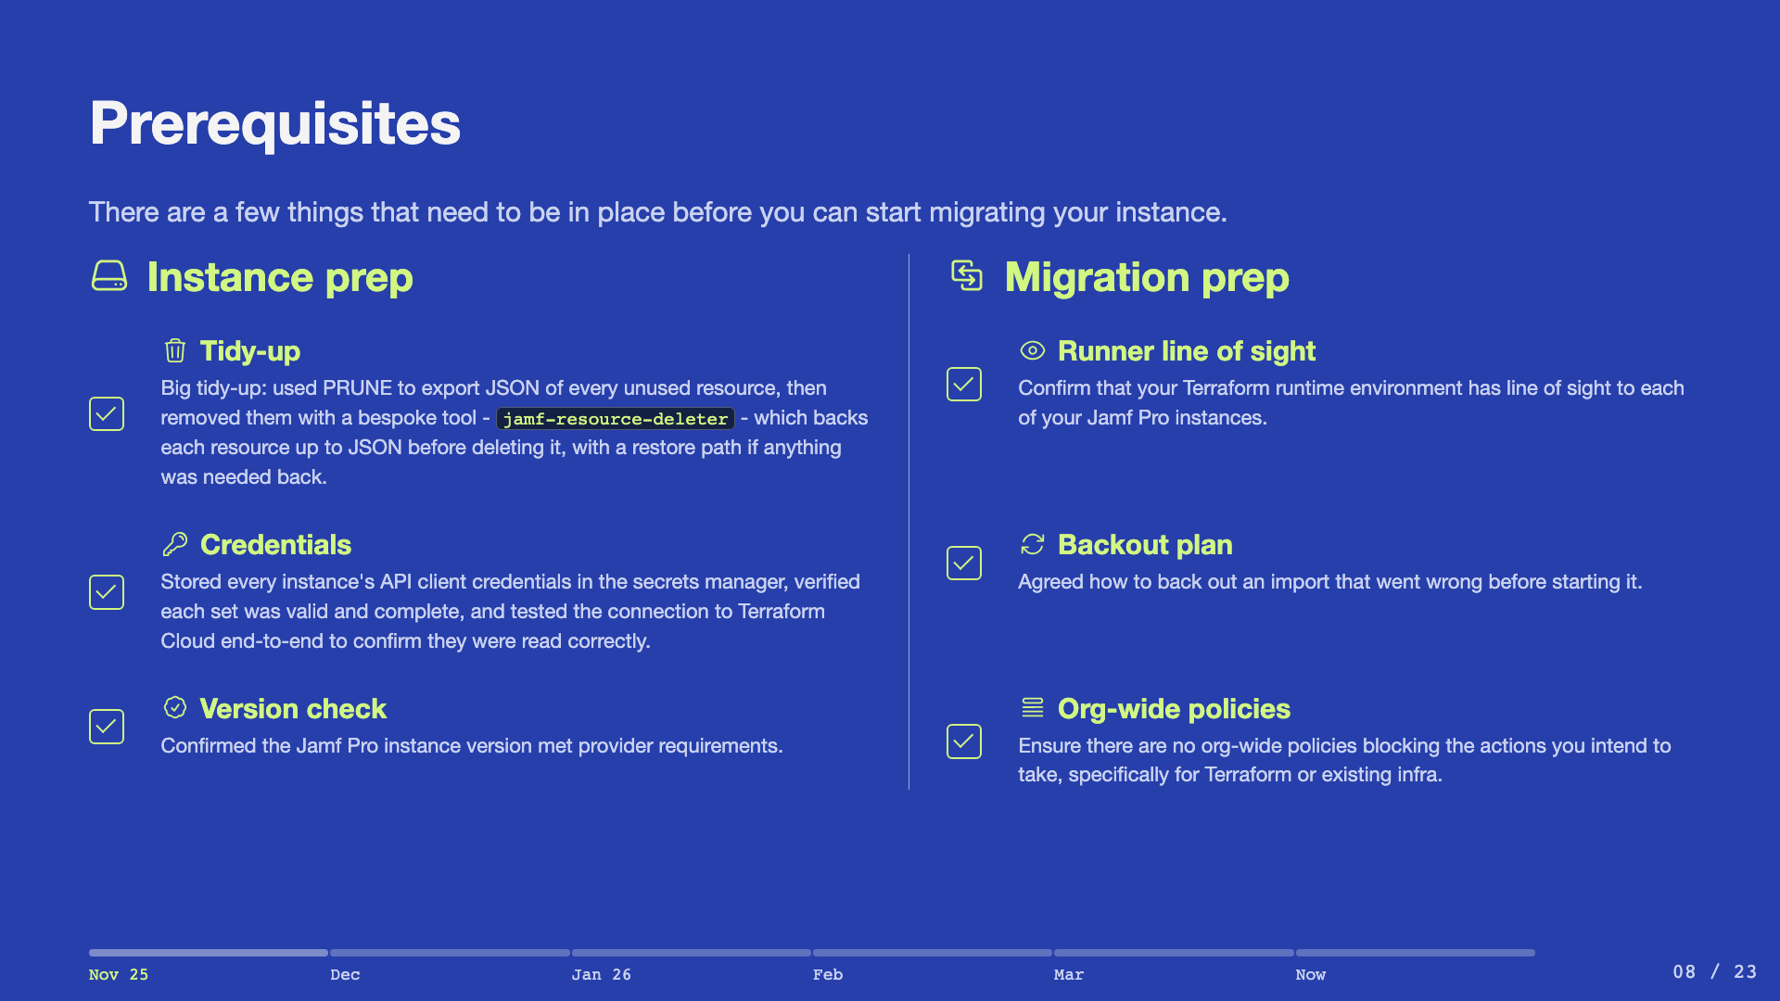
Notes:
The tidy-up mattered - importing dead config would have codified years of cruft. PRUNE found the unused resources; jamf-resource-deleter removed them safely, with a JSON backup and restore path in case anything was needed back. Migration prep sits alongside it: runner line of sight, a backout plan and a check for org-wide policies, agreed before the first import.

Slide 9
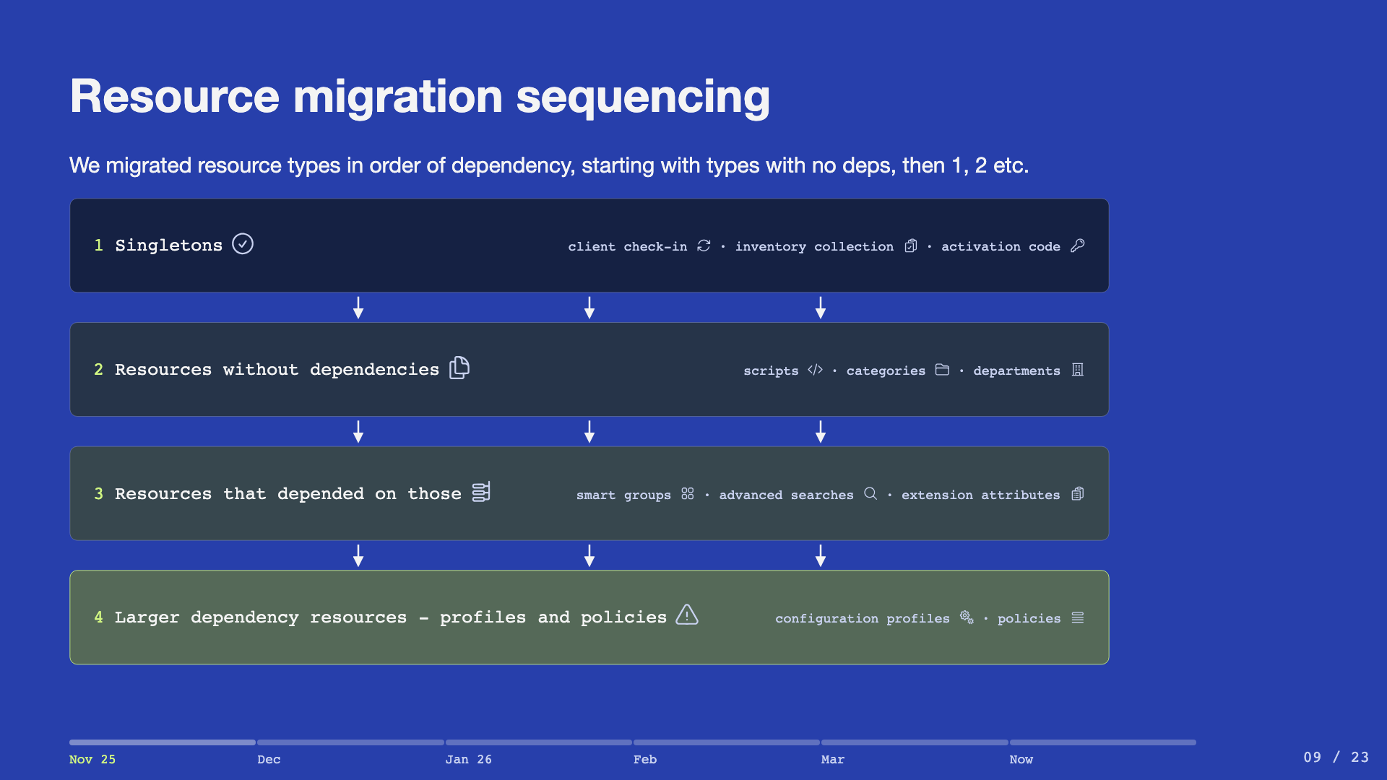
Notes:
The matrix is a spreadsheet the team built together. Risk scales with dependency fan-in: singletons carry none, scripts and categories and departments stand alone, smart groups and advanced searches and extension attributes sit on top of those, and profiles and policies sit on top of everything - so they close the migration. Also considered migrating instance-by-instance - rejected in favour of one resource type at a time, end to end.

Slide 10
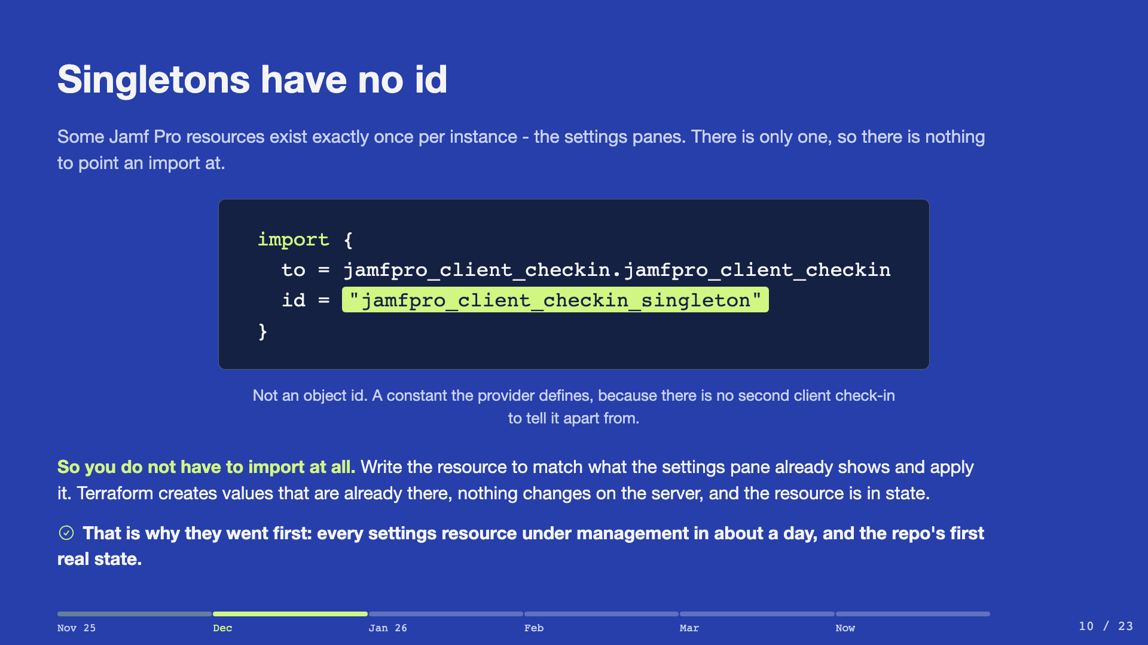
Notes:
November 2025 - the first real state in the repo. Point at the id and say what it is: a constant the provider made up, because a singleton has nothing to be identified by. There is only one client check-in. So the import ceremony is optional. Match the resource to what the UI already shows, apply, and Terraform writes values that are already there - no change on the server, but it is now in state. Every settings resource done in about a day.

Slide 11
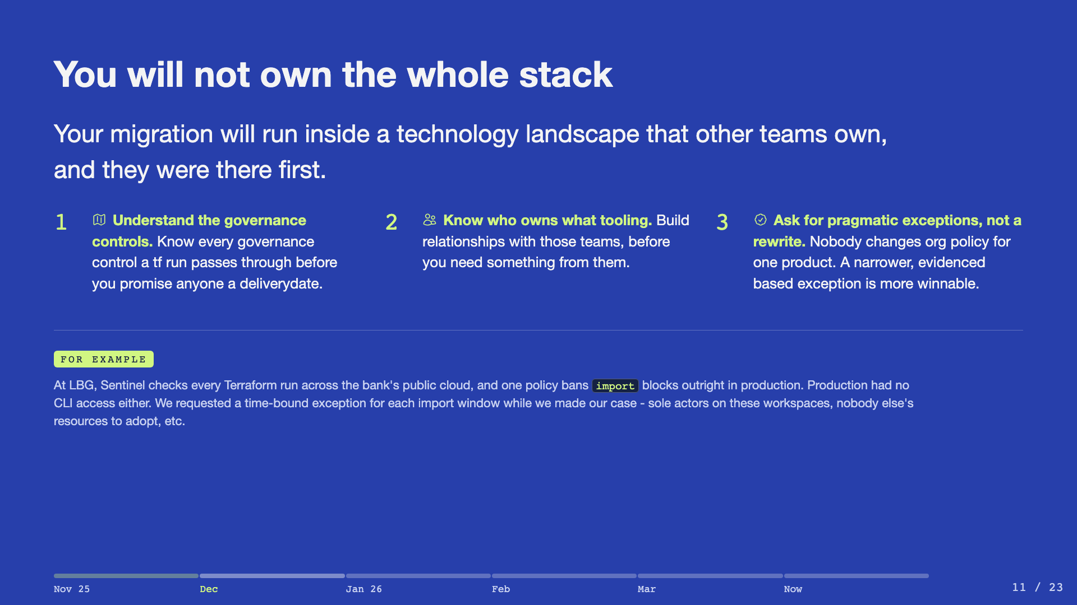
Notes:
The top of this slide is the part that transfers. Whatever they are migrating, it will run inside controls somebody else owns, and that is the normal case rather than bad luck. Take the three in order and keep them general - touch points, owners, exceptions. Do not reach for our story until they have landed. Then the example, briefly, as evidence that this is not theory: Sentinel bans import blocks across the bank's public cloud, production had no CLI, and what got us through was a narrow case on our own facts rather than an argument about the policy. Per-window exceptions first, standing exception once we had made it.

Slide 12
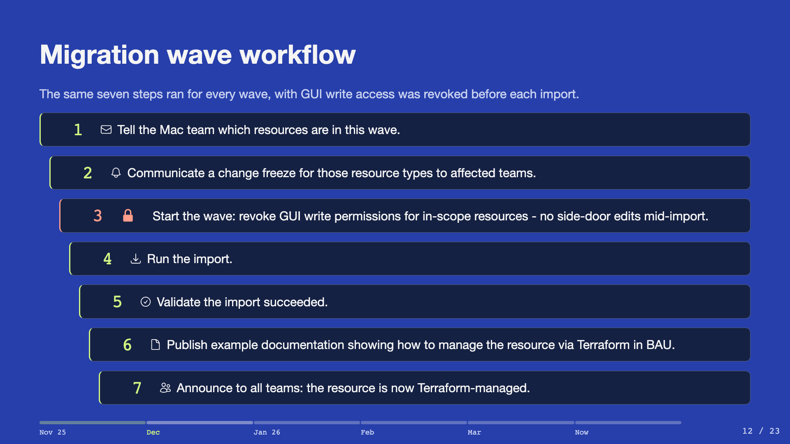
Notes:
Step 3 is the one people skip and regret - revoking write permissions makes the freeze real rather than polite. Bulk waves ran December into January.

Slide 13
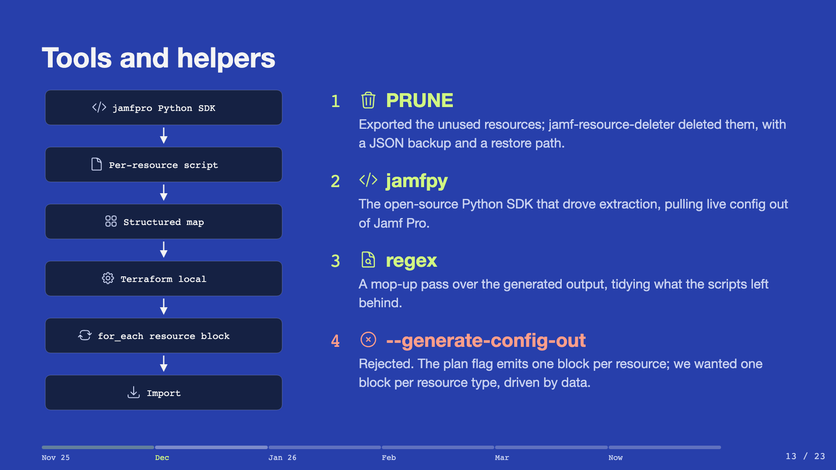
Notes:
jamfpy is Joseph's open-source SDK. Each candidate got a script emitting a structured map, duplicates and all. generate-config-out rejected: one block per resource; we wanted one block per type, driven by data. AI use in one line: an assistant validated the configuration and the dependency links, then move on.

Slide 14
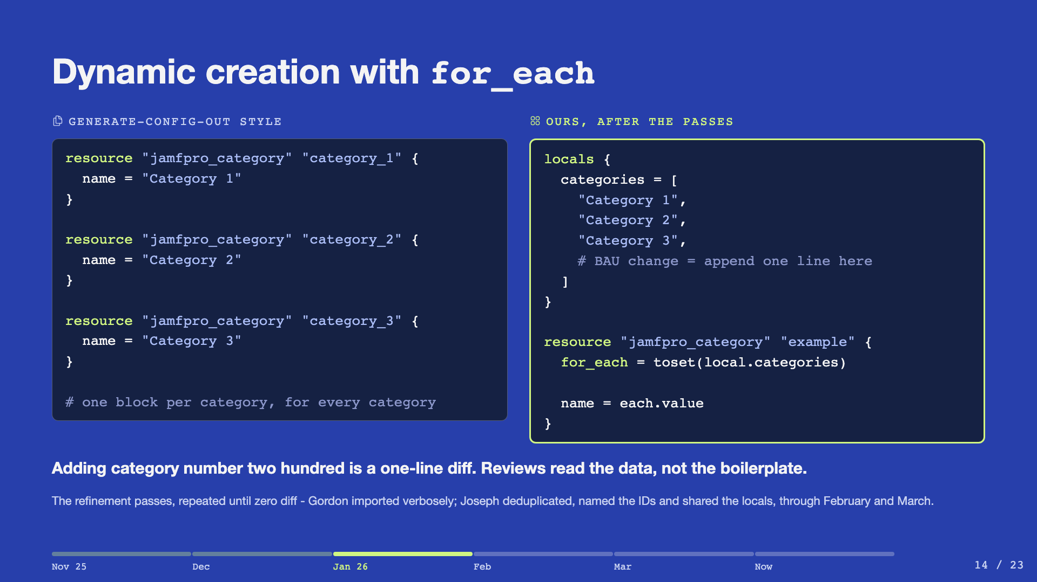
Notes:
The technical centrepiece. One block per type; adding category two hundred is a one-line diff; reviews diff data, not boilerplate. Division of labour: Gordon imported verbosely, Joseph refined in passes - dedup, name the IDs, share the locals - with a zero-diff plan after every pass, through February and March.

Slide 15
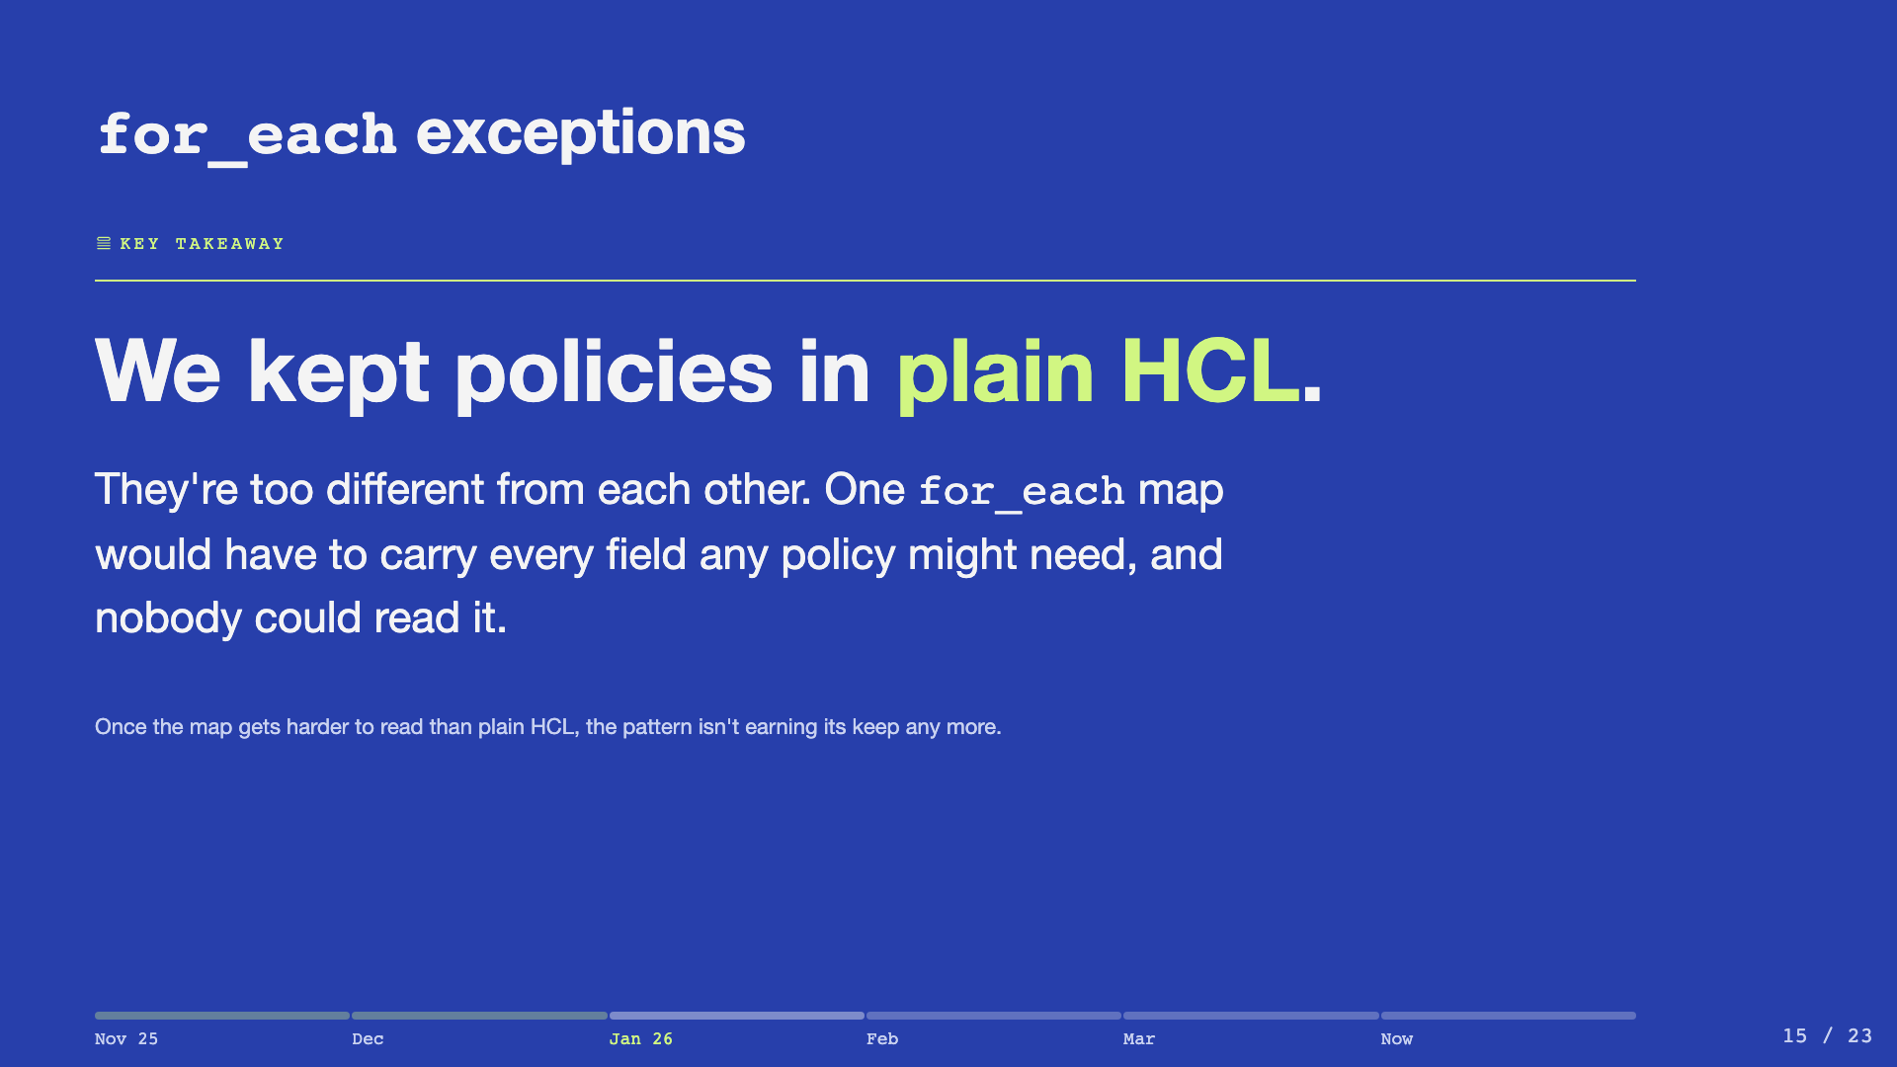
Notes:
This is the honesty slide - when the map's harder to read than plain HCL, the pattern isn't earning its keep. Policies were the one exception - they're too different from each other for one map to hold, so we kept them in plain HCL.

Slide 16
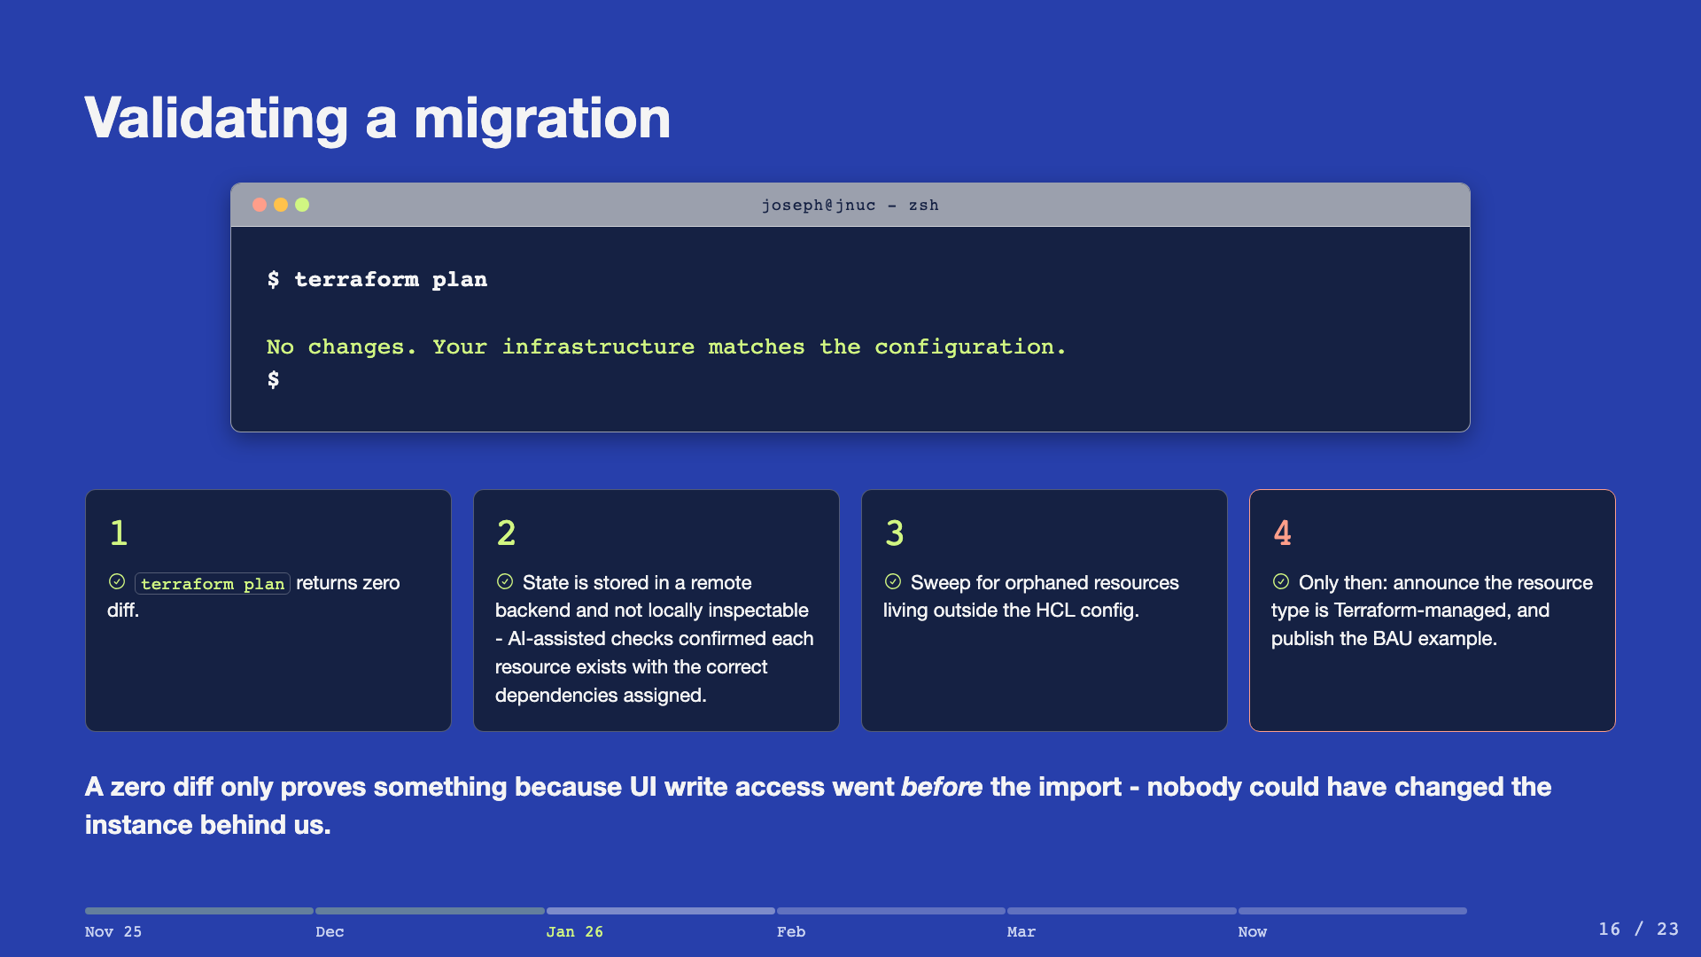
Notes:
Gate 4 is the point of no return - and the point of the whole exercise. State lives in a remote backend and is not locally inspectable, hence the AI checks in gate 2.

Slide 17
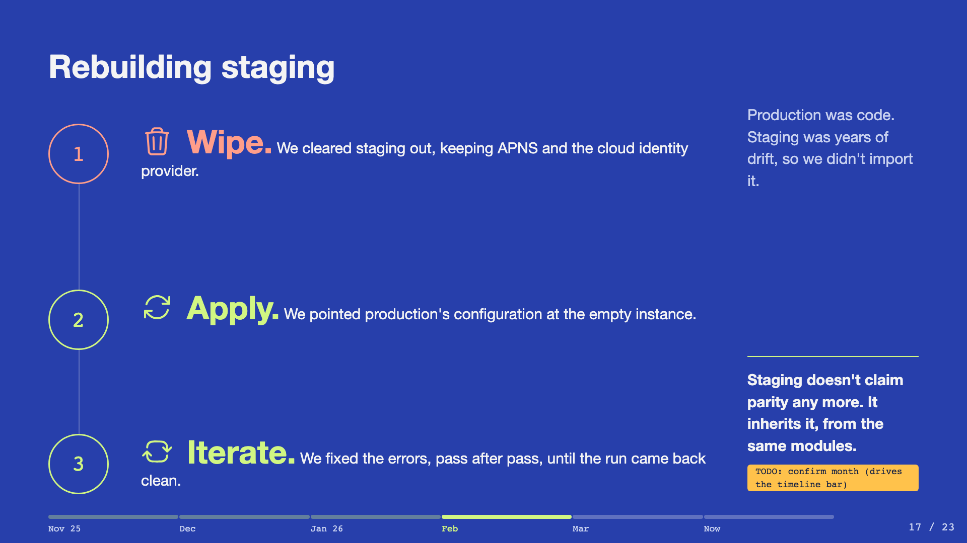
Notes:
This is the highlight - slow down here. Importing staging would have locked in years of drift. So we wiped it, kept APNS and the cloud identity provider, pointed production's configuration at it, and worked through the errors until the run came back clean. Parity is inherited now, not claimed. Set up the next two slides. Rebuilding staging is what showed up the repo problem: a real staging environment is only useful if you can deploy there first, and back then a change there went straight to production too.

Slide 18
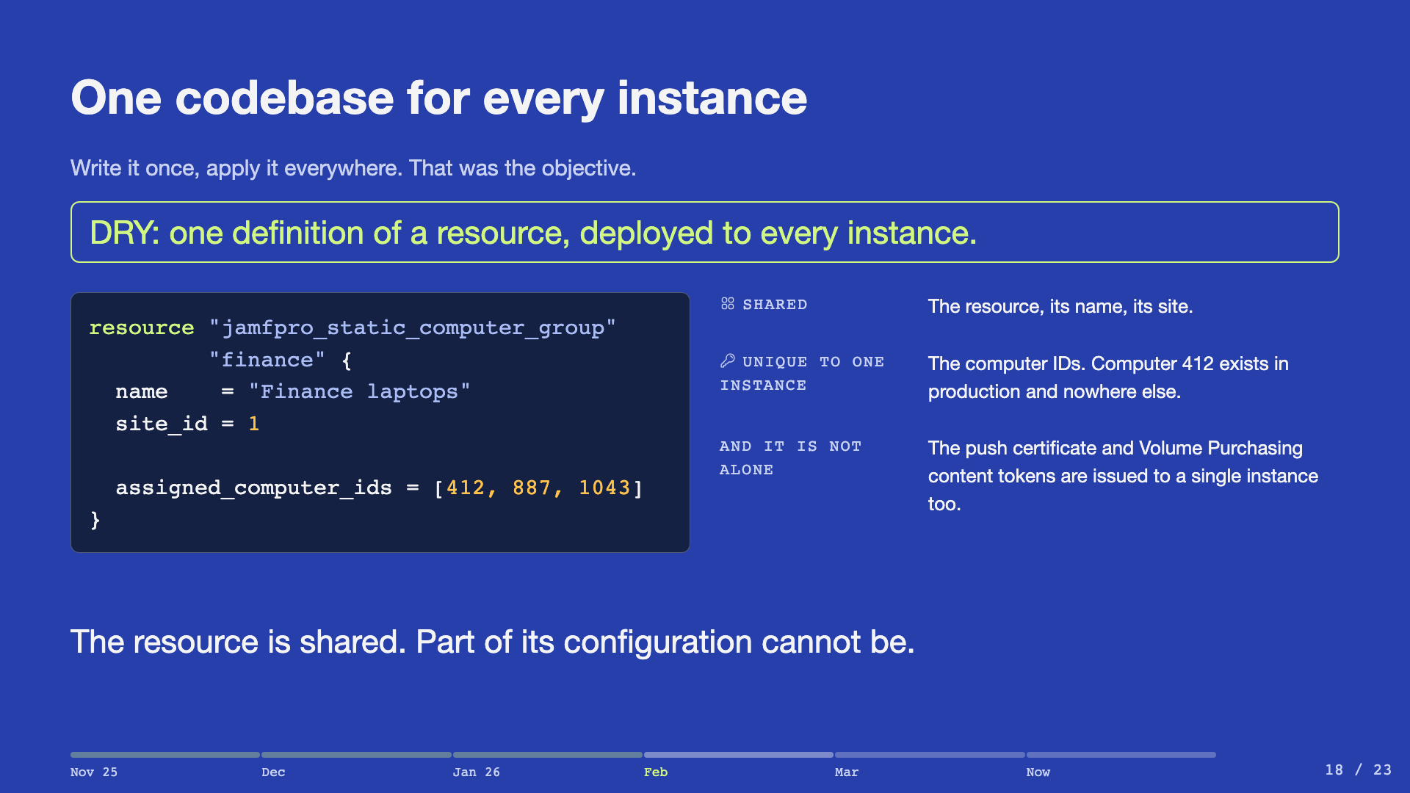
Notes:
Start with the objective, because it is the one everybody in the room has had: one Terraform codebase, applied to every Jamf Pro instance, so a change is written once and deployed everywhere. Then the block on the left, which is real provider schema. A static computer group takes computer IDs. Computer 412 is a machine in production, and it is nothing at all in staging, so that argument cannot be written once. The point is not static groups. They were the exception we expected and planned for. The point is that the same resource type has to carry configuration belonging to one instance, and we kept finding more of it as we built.

Slide 19
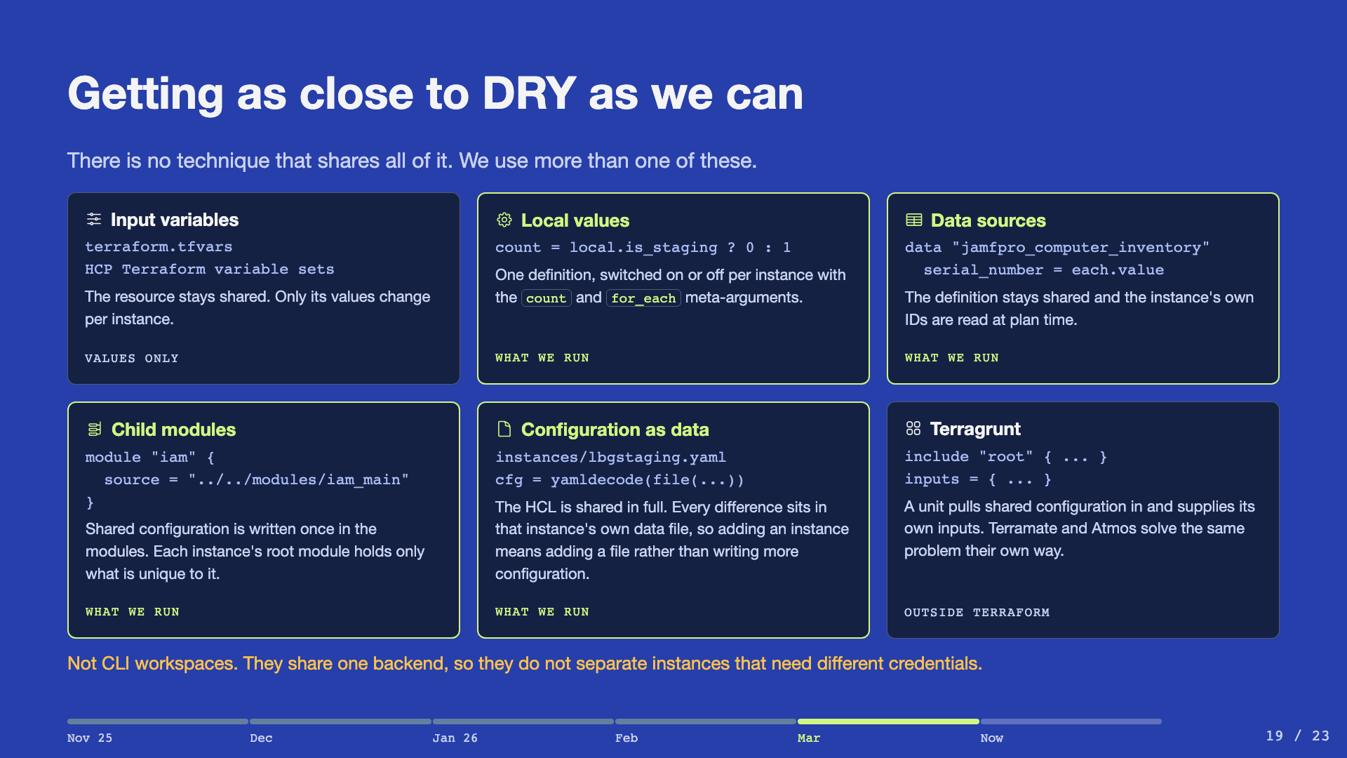
Notes:
Six techniques, and the honest answer is that there is no right one. Read them as a menu, not a ranking. We landed on child modules with a root module per instance, which is also what HashiCorp recommends where instances need different credentials and access controls. Shared code is written once; each instance's root holds only its own. Local values, data sources and configuration as data run alongside it, which is why four of the six are marked: switches on the resources, instance IDs read at plan time, and every remaining difference kept in that instance's data file so the HCL stops changing when you add one. Worth naming the one we did not reach for. Terragrunt was built for this problem, and Terramate and Atmos are the same idea productised. Finish on the caution. CLI workspaces sound like the answer and are not, because they share a backend. Slide 4 already separated the two meanings of workspace.

Slide 20
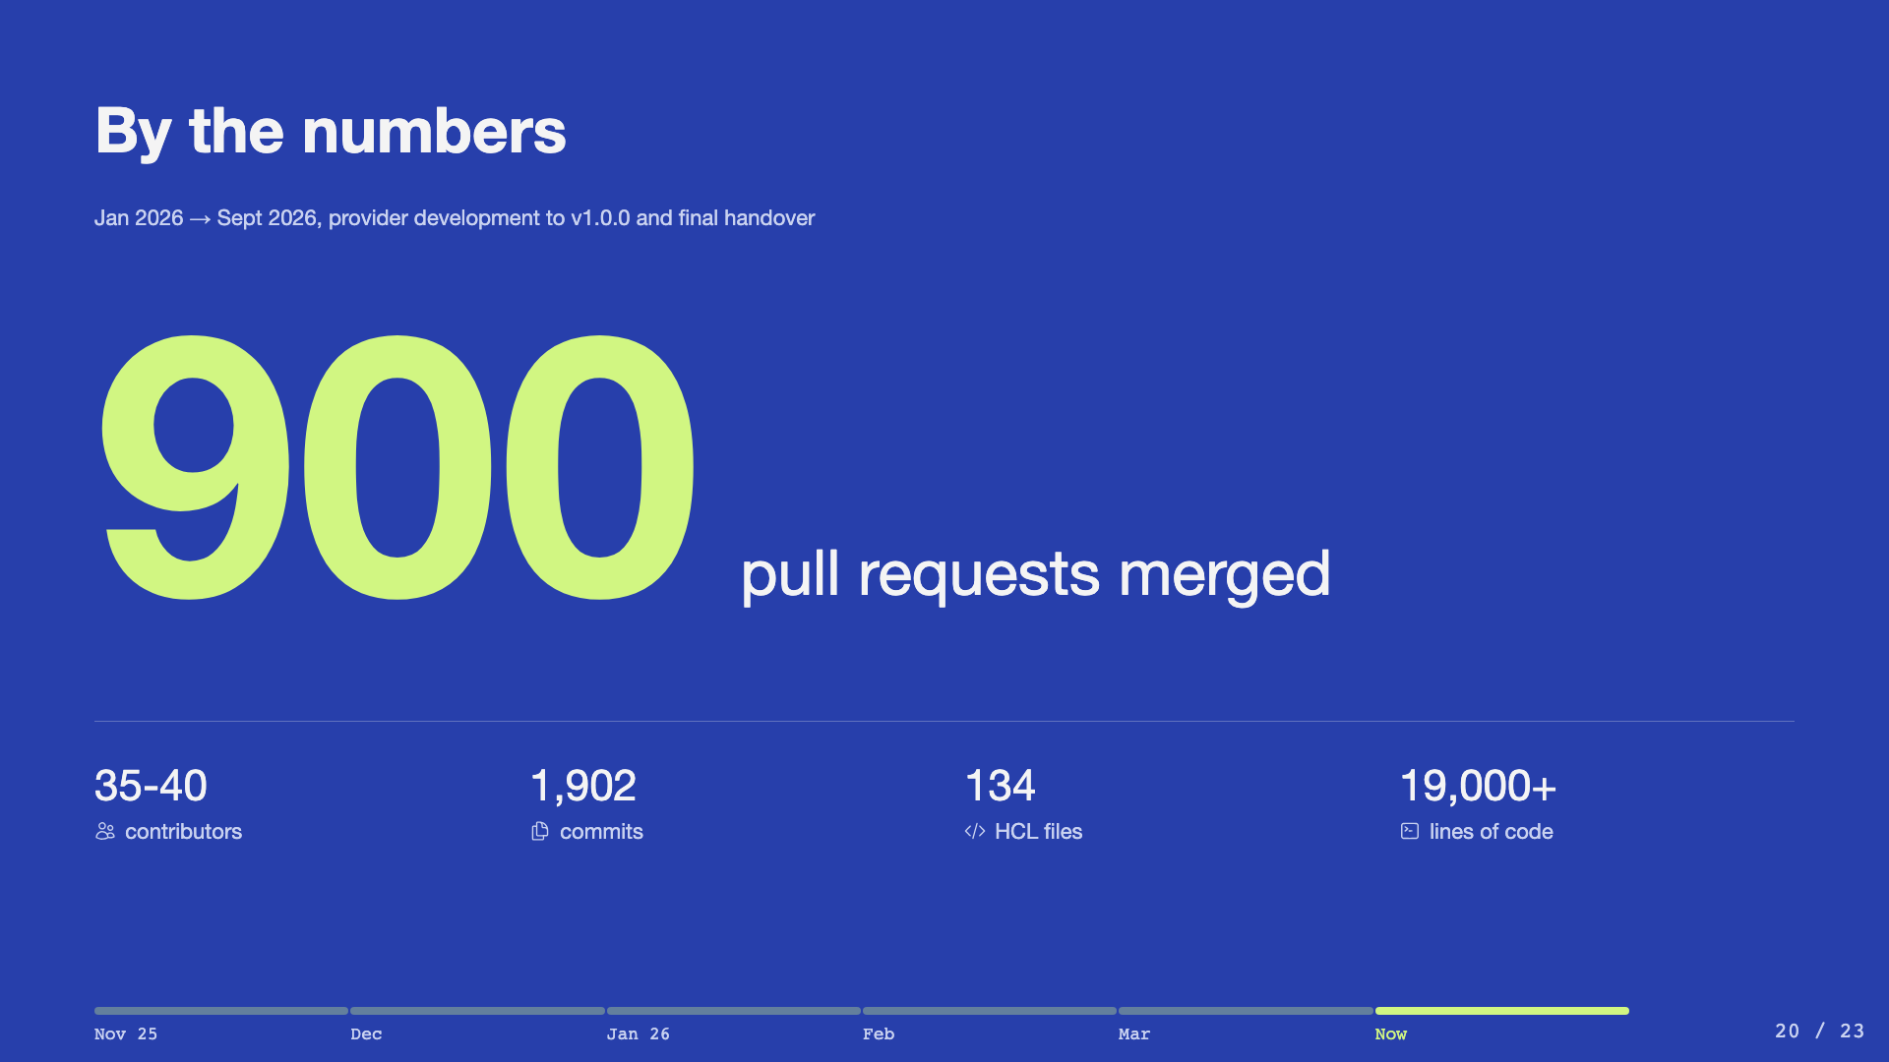
Notes:
Split the timeline or the room hears thirteen months of migration. April 2025 is the provider-development start; nothing was imported before November 2025. May 2026 is both v1.0.0 and the final handover, with the Mac engineering team working proficiently on their own. Close on the handover, not the stats: approaching a thousand pull requests now, and none of the three of us are on that team any more. The estate is still moving. That is the real number on the slide.

Slide 21
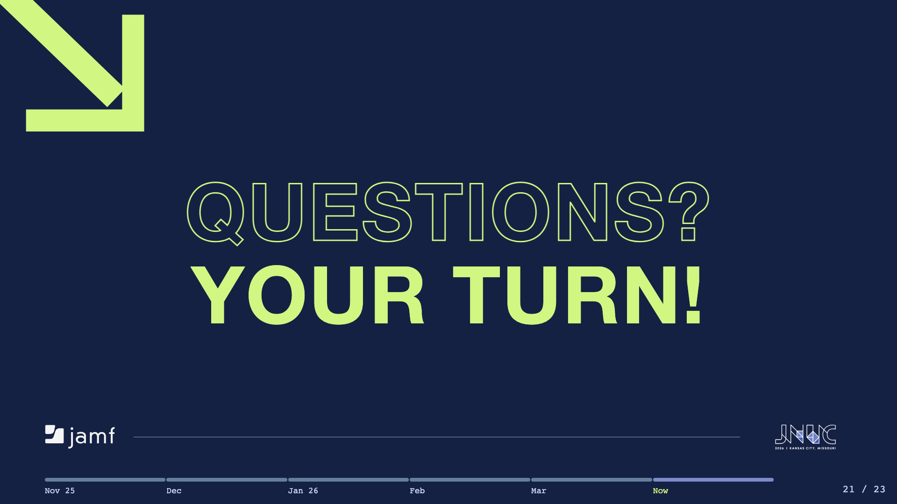
Notes:
Open the floor. The links slide is next, ready as the backdrop while questions run.

Slide 22
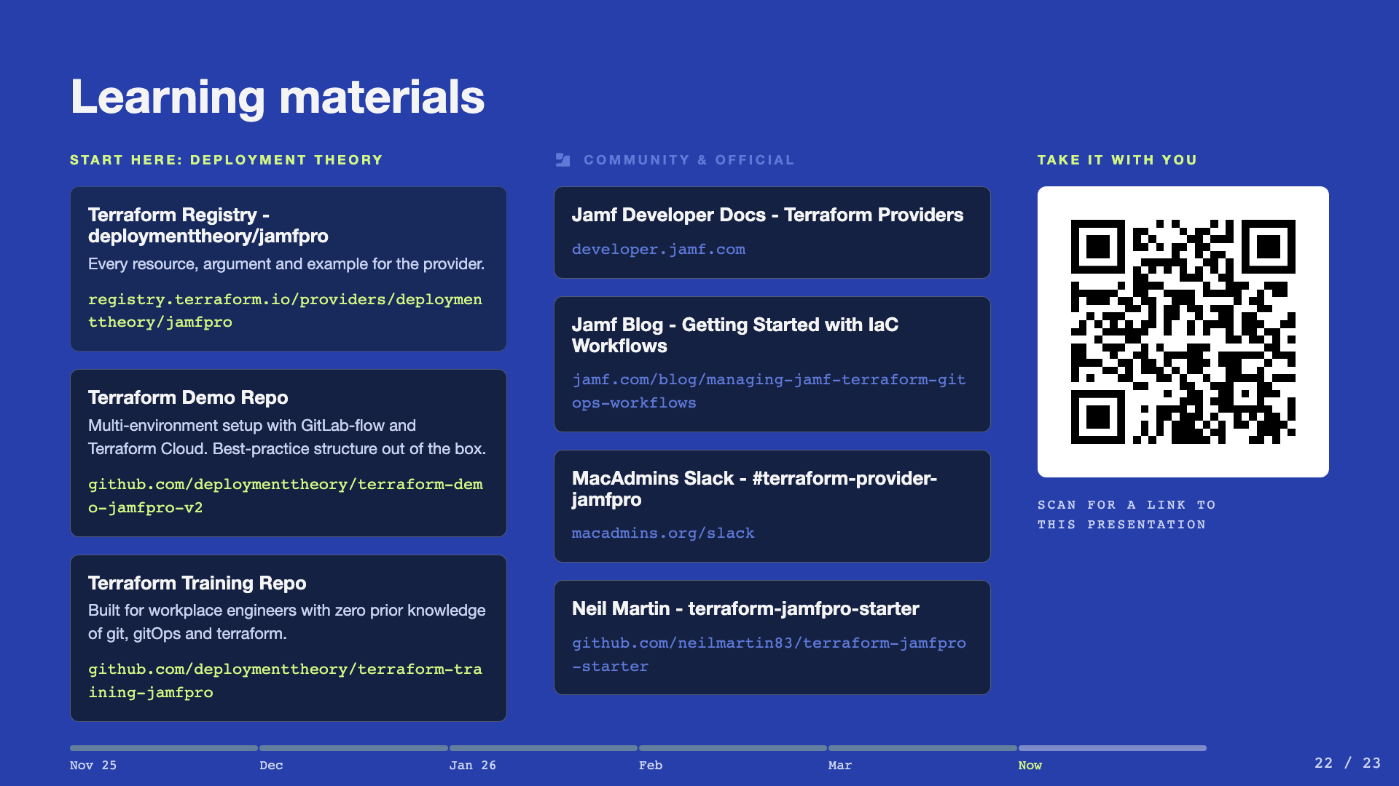
Notes:
Where to send people. Start with the Deployment Theory Terraform registry and demo repo, and the training repo built for workplace engineers. Then the community and official set: Jamf developer docs, the Jamf blog IaC walkthrough, the MacAdmins Slack channel, and Neil Martin's starter repo. Point at the QR code on the right and leave this slide up while questions run - it opens a link to this presentation, so nobody needs to photograph the URLs.

Slide 23
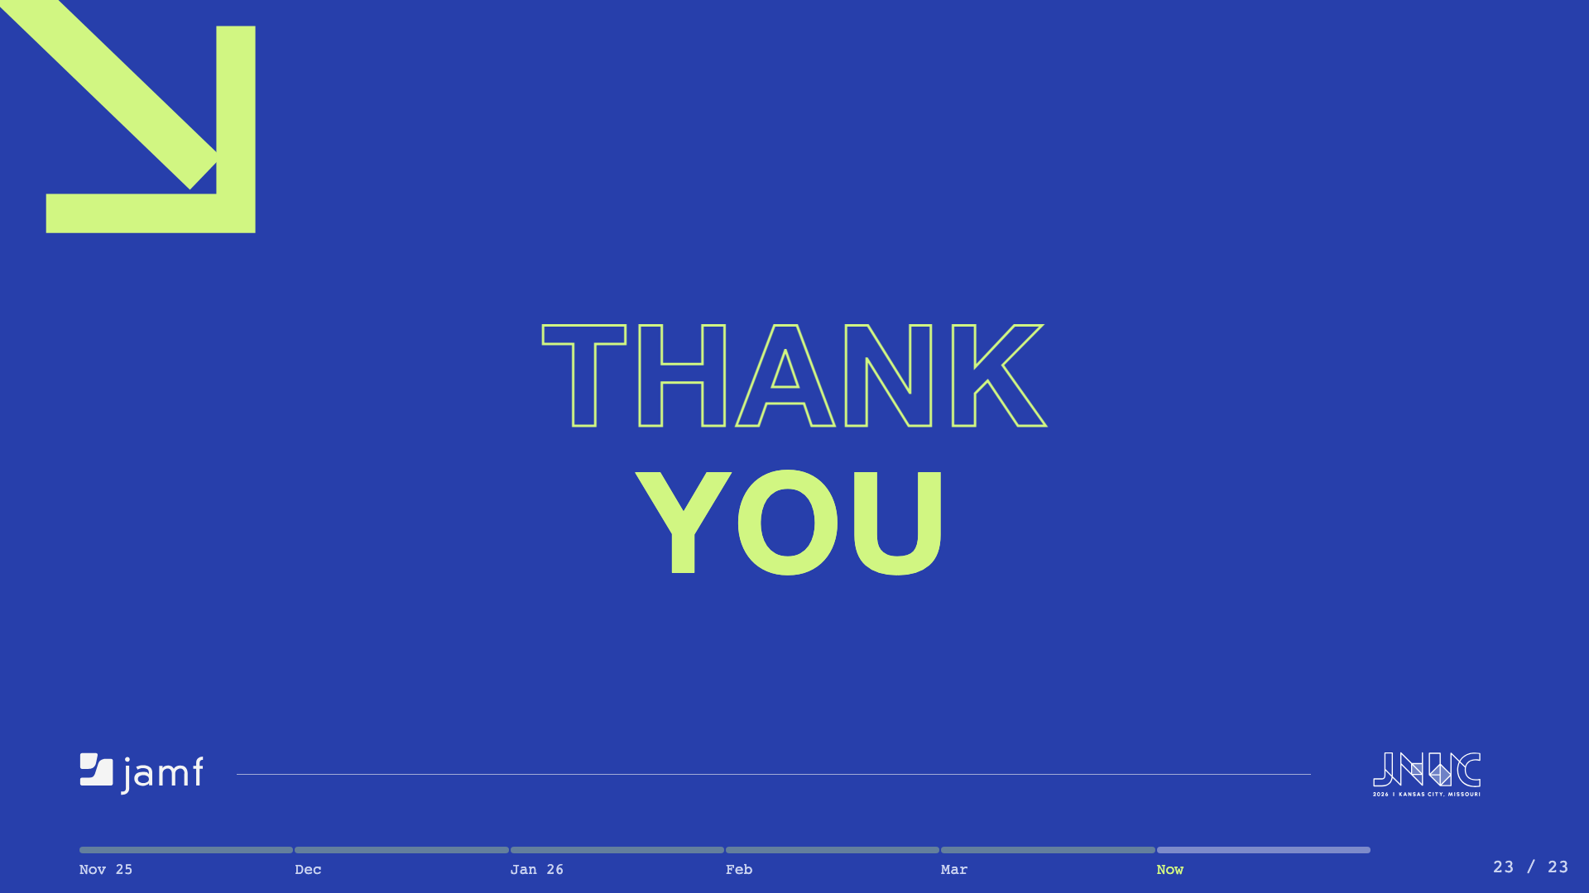
Notes:
Thank the room and close - this is the walk-out backdrop.

